Slide 1
Unlocking Innovation
How Model-Based Approaches Drive Better Products Faster
Link to Mural Presentation

Slide 2
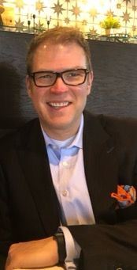
Creg Schumann
Product Guy – Orpheo Consulting – St Paul, MN – Email: creg@cregschumann.com – 612.703.1470
Creg started his career doing assembly language and C coding – now his coding experience is relegated to
simple web sites for non-profits he volunteers with. Informed by a good understanding of building cool things,
he was an early adopter and adapter of agile techniques from the likes of DSDM, SCRUM and other flavors
(before there was an agile manifesto).
He’s been part of large teams/organizations or small teams in many industries and solution spaces. Some of his clients he’s worked with on transformation are American Airlines, Disney, Ecolab, US Bank, Wells Fargo, Optum, United Health and many others. He focuses on a whole product and bringing that to market. A whole product is what the customer is buying and all the other enabling pieces. The fun times Creg has at work is in the innovation space. Working with a client in a dark space – trying to get a better idea of the problem or opportunity – and emerging with a novel solution.
He’s part of and/or organizes local meetup groups and participates in peer learning groups on facilitation and virtual learning. He’s worked with and learned from some amazing people over his career. He pushes for a pragmatic environment and helps teams move away from dogmatic systems.
When he’s not working with teams producing things, he loves building furniture and gardening as well as being active in the local community by way of serving on various boards of directors for non-profits.

Slide 3
Why Use Models?
It’s faster and creates shared understanding
Throughout many fields of work, we find numerous examples of visual models
and representations that facilitate early discovery of what will be built.
These tools aid in understanding concepts and fostering alignment among
stakeholders and team members.
However, within the digital product space, we often find ourselves relying heavily on documentation to outline requirements. This involves breaking down larger tasks into smaller ones to fit into a sprint, a process commonly known as refinement. But using a written approach for this essential discovery process can be extraordinarily expensive. It can also focus on breaking down known requirements and not used models to discover unknowns.
Moving to using models (drawing, diagrams, etc.) that discover new and break down existing ideas makes this process much faster.
Using model-based discovery
moved 30 teams from:
64 weeks from Idea to Delivery
11 weeks from Idea to Delivery

Slide 4
Idea
Requested
Build
Start
Delivery
Product Discovery
Product Delivery
Cycle Time
Lead Time

Slide 5
high
face-to-face at whiteboard
face-to-face
video conversation
phone conversation
medium
modeling options
media richness and effectiveness
videotape
email conversation
audiotape
band of effective media
paper
documentation options
medium
low
low
medium
high
task complexity
Adapted from Richwald 1998 and Cockburn/Ambler 2002

Slide 6









I’m glad we all agree.
Oh….
Ah ha!
I’m glad we all agree!

Slide 7
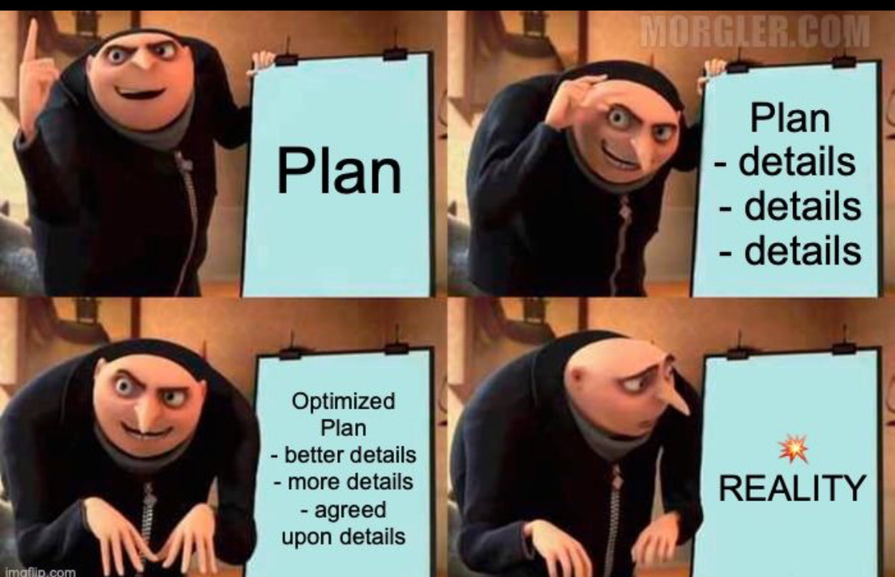

Slide 8
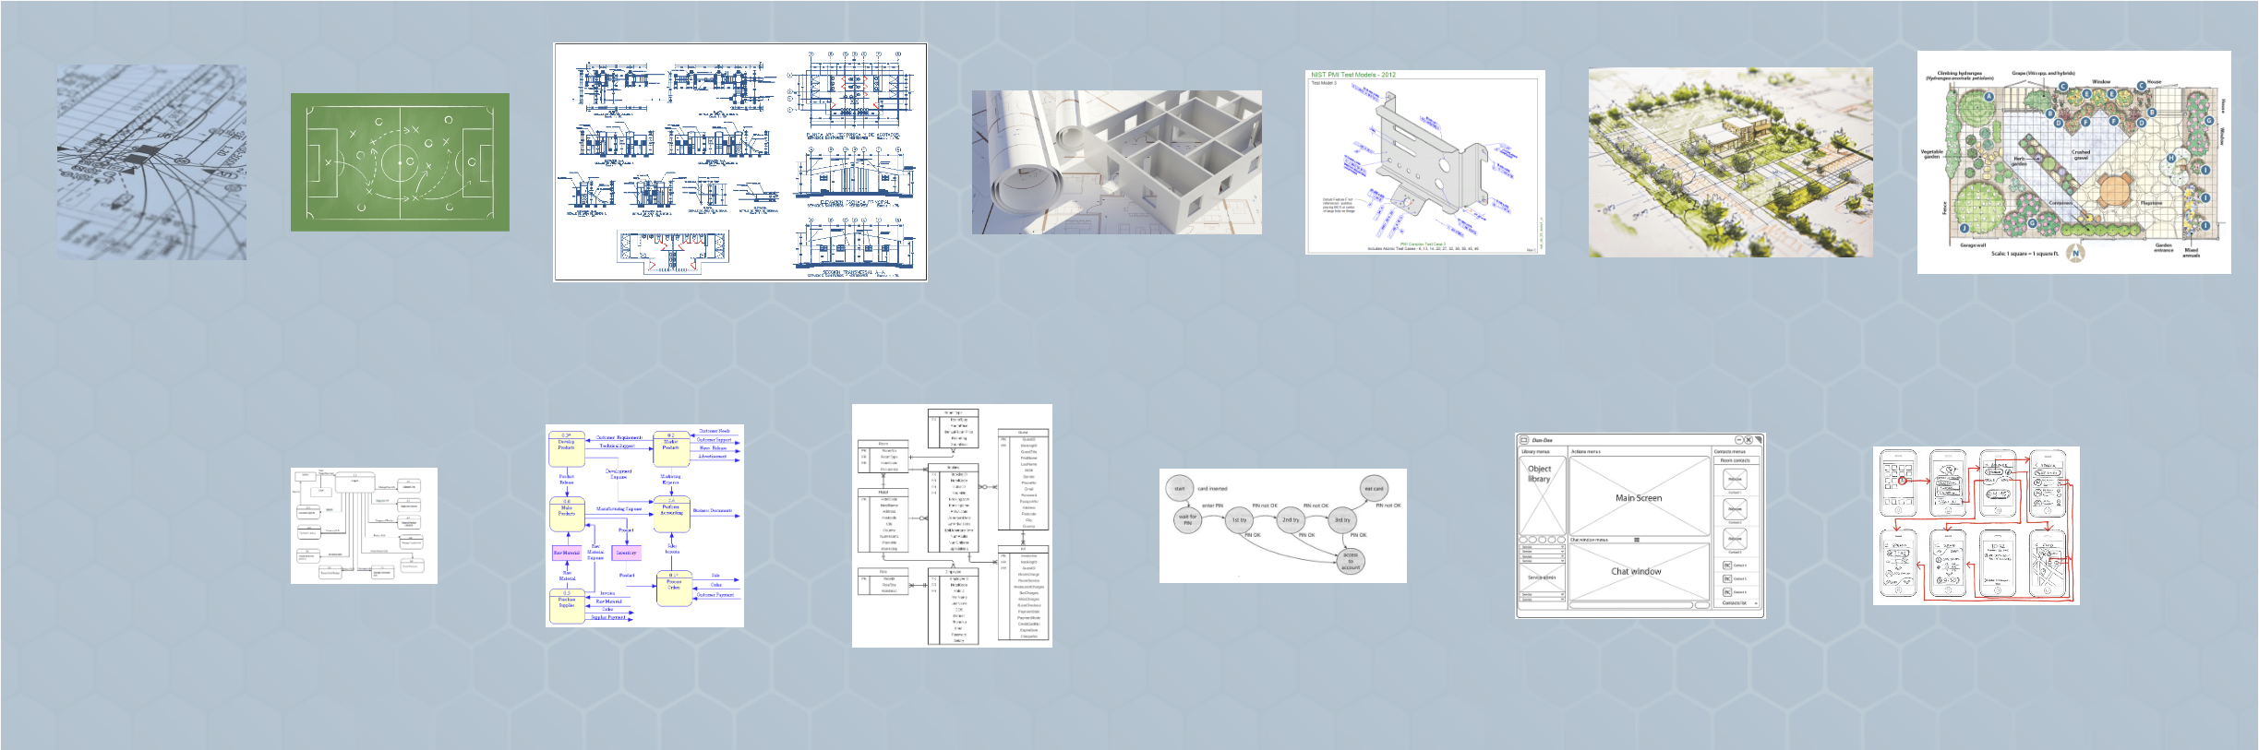

Slide 9
Individuals & Interactions
Process & Tools
OVER

Slide 10
Economics and Comprehension of Models
Communication
Iteration & Adaption
Collaboration
Learning Curve
Overview vs. Detail
Incremental Detail
Detail vs Overview
Models have the advantage over written documents for having a conversation that results in shared understanding.
Models lend themselves to getting high-level understanding, then breaking it apart with another model that explores more detail.
It’s easy for teams to quickly understand and work more in detail with a different type of model so they can bring back, inspect and adapt.
Models have learning curves, However, using a model gives a team speed that eclipses using written documents to gain a shared understanding.
If an overview is needed for a large feature, models are often the best way to gain that understanding.
Process elaboration is natural as additional details are discovered. Models are a great way to drill down to more detail.
Documenting detailed steps in processes helps teams focus on the complexity of the build.

Slide 11
One initiative over 64 weeks delivers some value
Reduce cycle time for same value by 83%
Some Value
Some Value
Some Value
Some Value
Some Value
Equals more valuable things: competitive advantage

Slide 12
COMPANY VISION
BUSINESS STRATEGY
PRODUCT VISION
PRODUCT STRATEGY
RELEASE PLAN
SPRINT PLAN
DAILY PLAN

Slide 13
Organization Strategy & Vision
VISION
Business Model
Customer Segments
Vision/Purpose
STRATEGY
Goals & Initiatives
Personas
Customer Jobs
OPPORTUNITIES
Story Maps
SOLUTIONS
User Experience Design
EXPERIMENTS
Product Backlog
Roadmap
DELIVERY
Build and Deliver
Product Ops & Validation

Slide 14


Slide 15
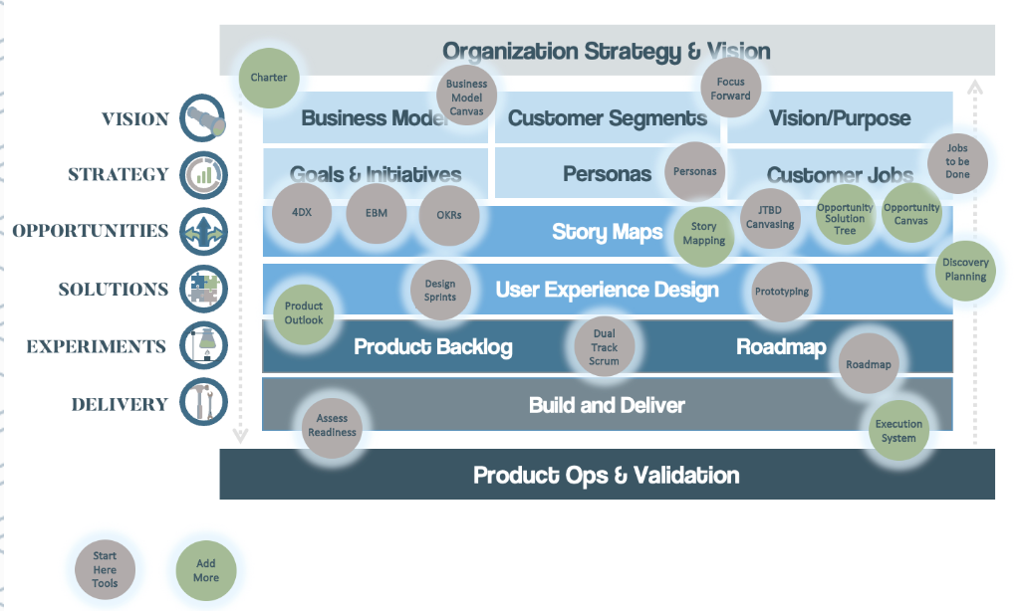

Slide 16

Organization Strategy & Vision
VISION
Business Model
Customer Segments
Vision/Purpose
STRATEGY
Goals & Initiatives
Personas
Customer Jobs
OPPORTUNITIES
Story Maps
SOLUTIONS
User Experience Design
EXPERIMENTS
Product Backlog
Roadmap
DELIVERY
Build and Deliver
Product Ops & Validation

Slide 17
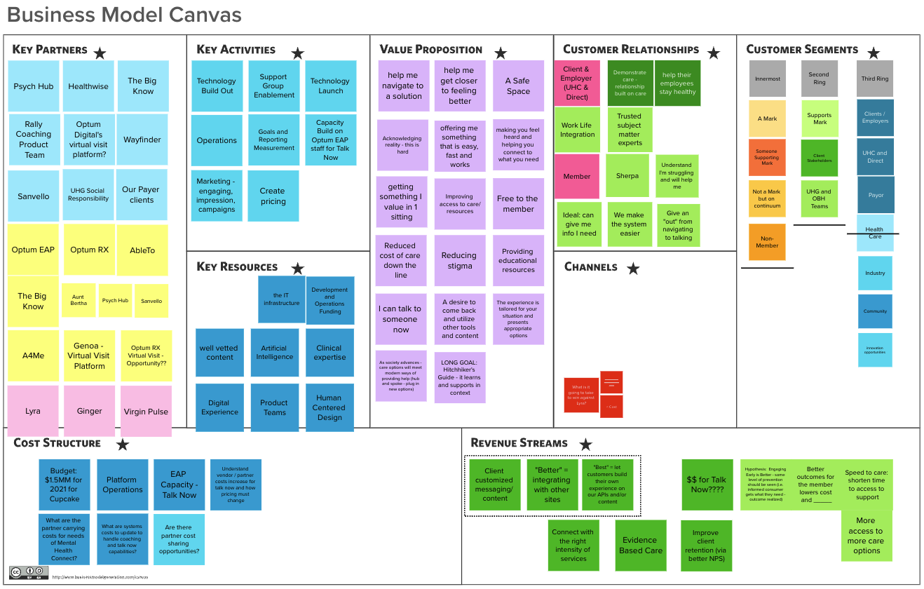

Slide 18


Organization Strategy & Vision
VISION
Business Model
Customer Segments
Vision/Purpose
STRATEGY
Goals & Initiatives
Personas
Customer Jobs
OPPORTUNITIES
Story Maps
SOLUTIONS
User Experience Design
EXPERIMENTS
Product Backlog
Roadmap
DELIVERY
Build and Deliver
Product Ops & Validation

Slide 19
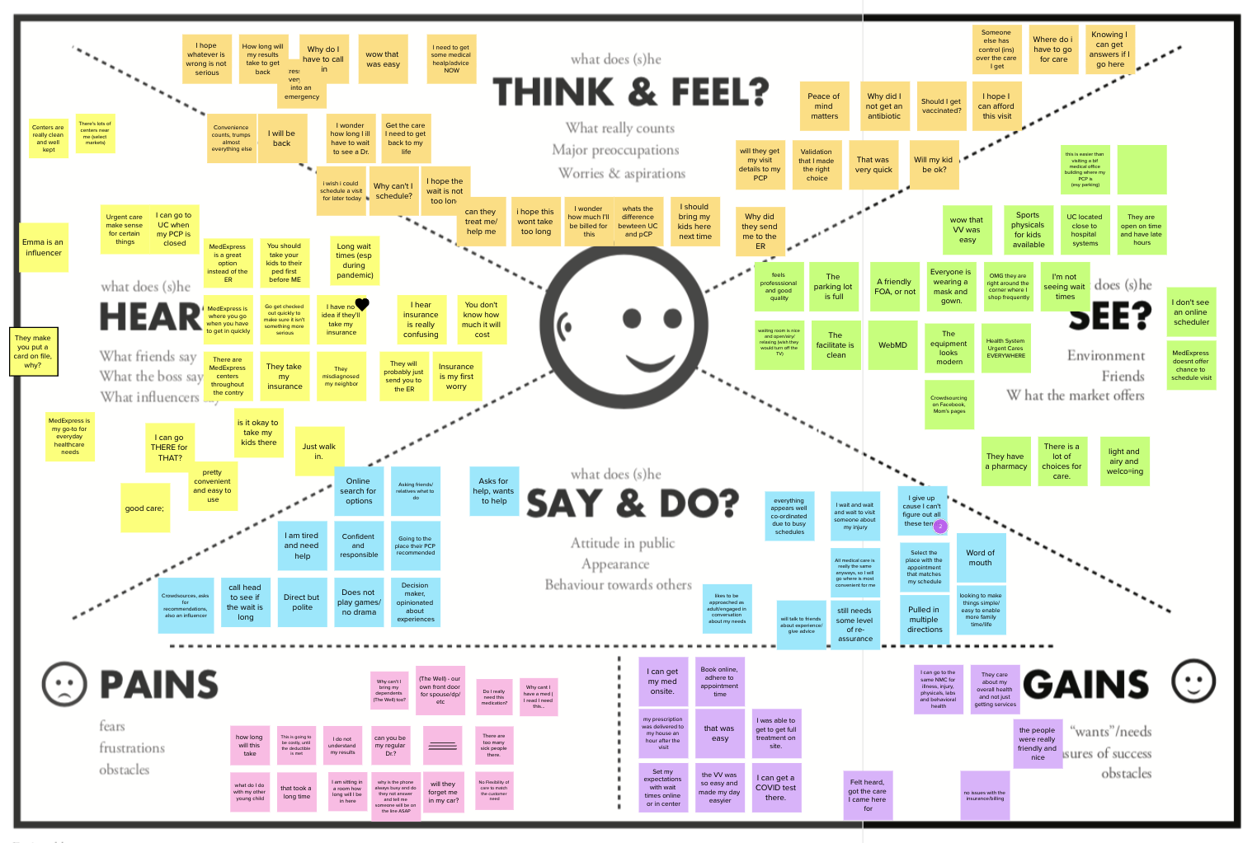

Slide 20

Organization Strategy & Vision
VISION
Business Model
Customer Segments
Vision/Purpose
STRATEGY
Goals & Initiatives
Personas
Customer Jobs
OPPORTUNITIES
Story Maps
SOLUTIONS
User Experience Design
EXPERIMENTS
Product Backlog
Roadmap
DELIVERY
Build and Deliver
Product Ops & Validation

Slide 21
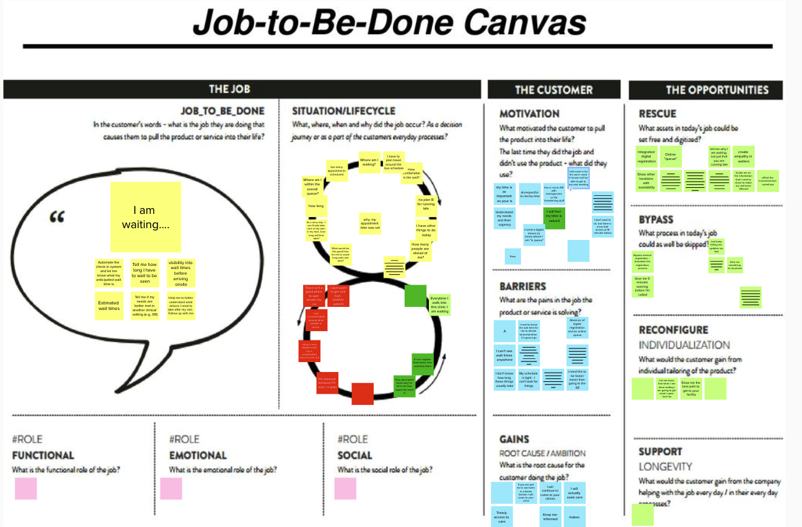

Slide 22
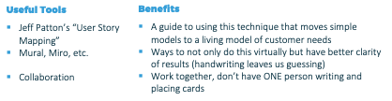
Organization Strategy & Vision
VISION
Business Model
Customer Segments
Vision/Purpose
STRATEGY
Goals & Initiatives
Personas
Customer Jobs
OPPORTUNITIES
Story Maps
SOLUTIONS
User Experience Design
EXPERIMENTS
Product Backlog
Roadmap
DELIVERY
Build and Deliver
Product Ops & Validation

Slide 23
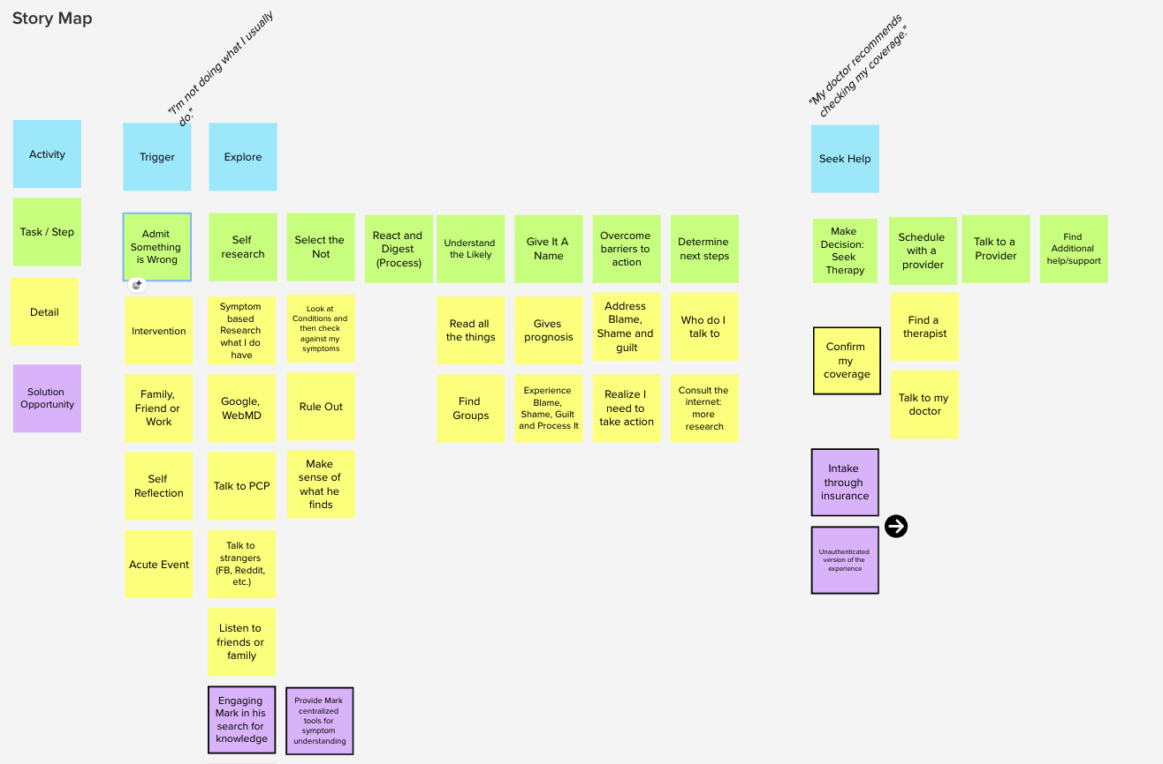

Slide 24
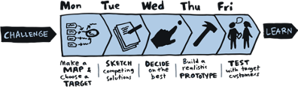

Slide 25
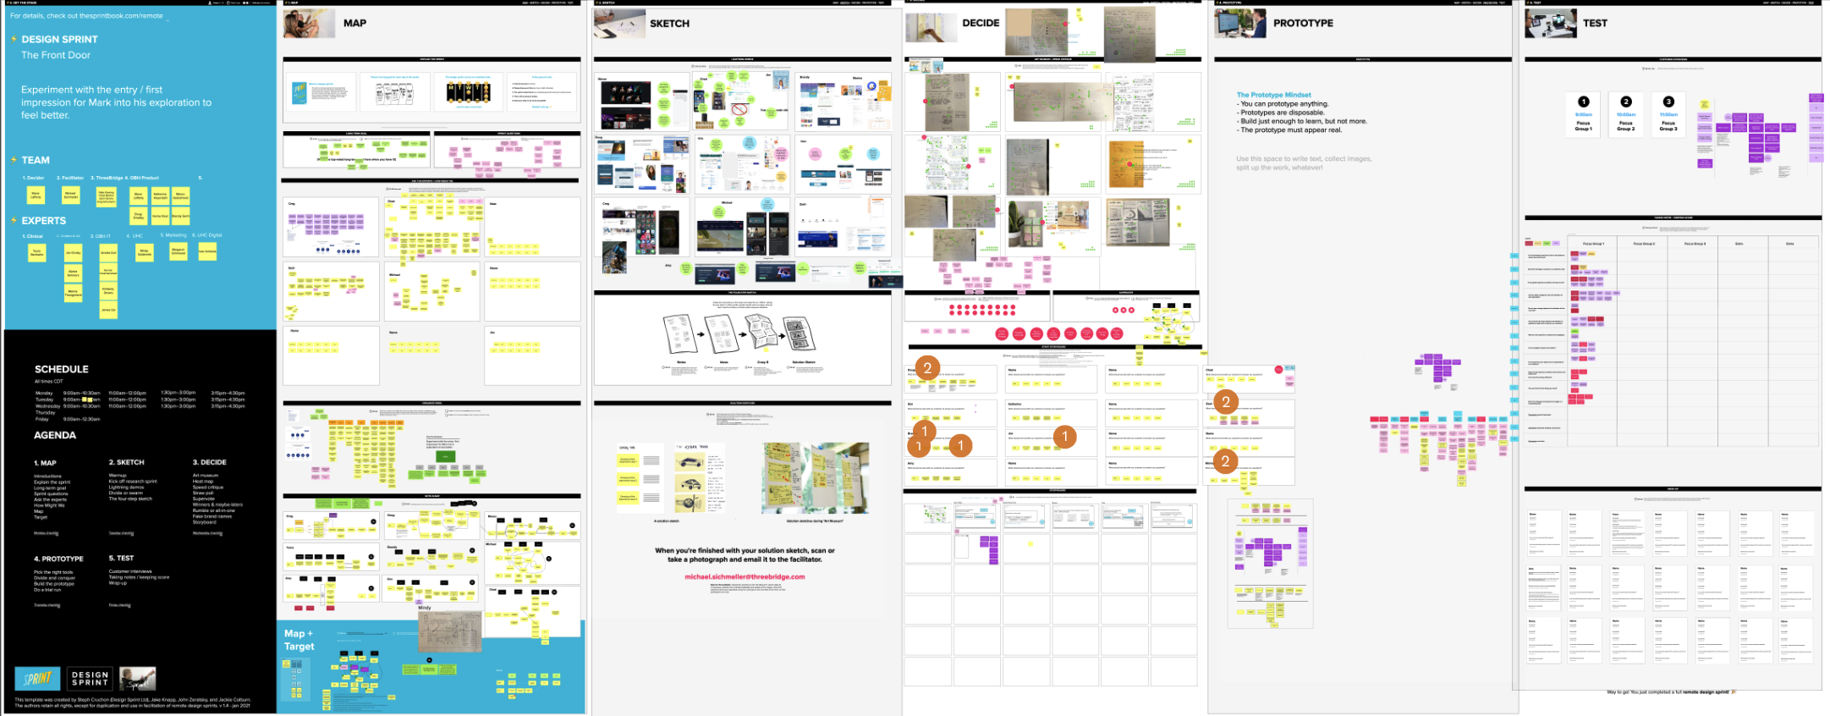

Slide 26
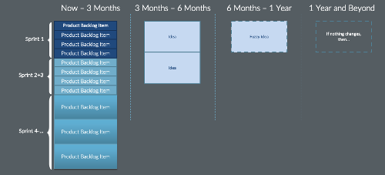


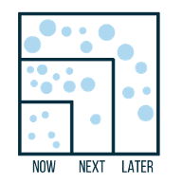
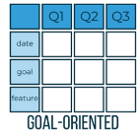

Slide 27

What Management Typically Measures
What Often Goes Unmeasured
On-Time Delivery
Budget Adherence
Resource Utilization
✓ Checked Daily
✓ Tracked Weekly
✓ Monitored Monthly
❌ Rarely Assessed
❌ Often Ignored
❌ Delayed Analysis
❌ Not Considered
Customer Satisfaction
Product-Market Fit
Revenue Generation
Long-term Value
Project
Launch

Slide 28
It’s faster.
It drives alignment.
It produces better products.
- Creg Schumann
Give a man a fish and you feed him for a day.
Teach him how to fish and you feed him for a lifetime.
- Chinese Philosopher Lao Tzu, founder of Taoism
Children are the Research and Development division of the human species.
- Alison Gopnik

